Slide 1

Demo ML Forecasting Project All Data has been altered from Original Project Data

Slide 2
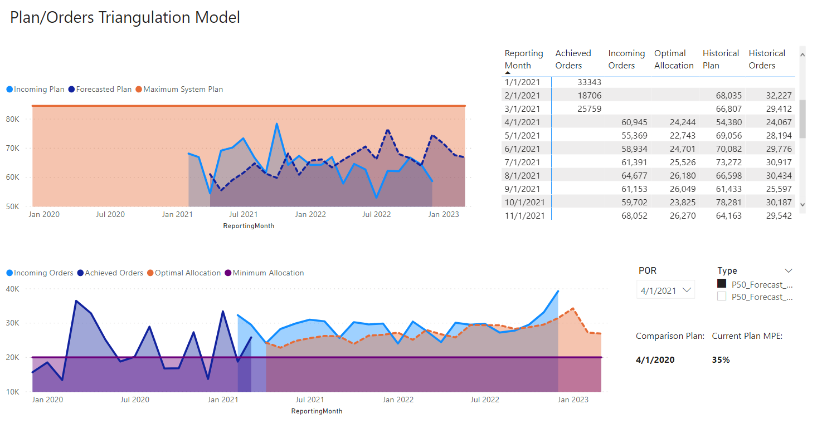
Major Manufacturing Company: Need Forecasting Model For Plan/Order Triangulation
Order Volumes are used to plan for two-year supplier contracts
Orders are created from requests to increase cloud capacity
Upper Limit bounds ensure up-to-date SLA

Slide 3
Upgrade to classified orders Model : Two Part Vision is to: Understand recurring events (Big One-time customers and one-time events Add more features to the Model reacting to: New Supplier launches Capacity constrained Suppliers New Product Introductions Lower grained Forecasts may not improve accuracy, but may provide additional insights

Slide 4
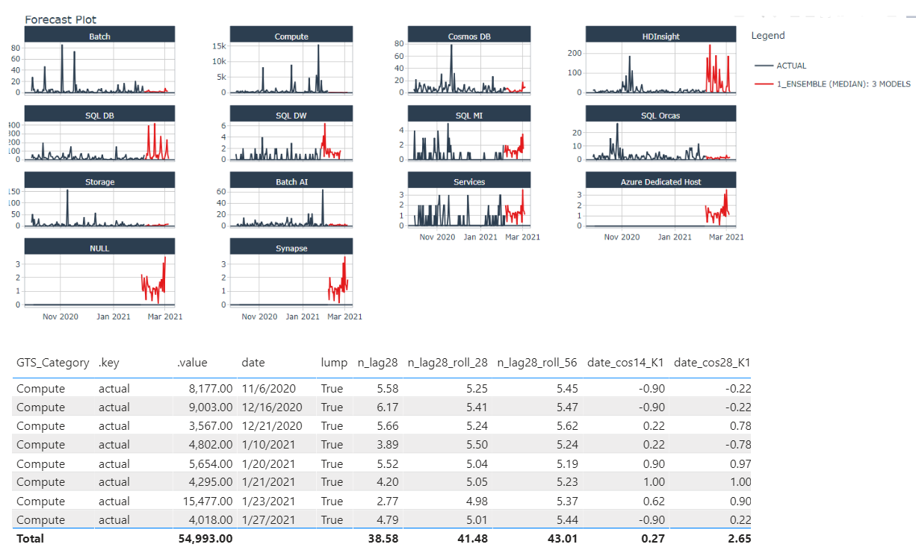
Model Phase II: Reoccurring Events/Seasonality
Intelligent classification of orders into smaller subgroups
Grouped Time Series Forecasts (GTS) allow us to provide order seasonality to stockholders at different groups
ML time-series Model to drive seasonality

Slide 5
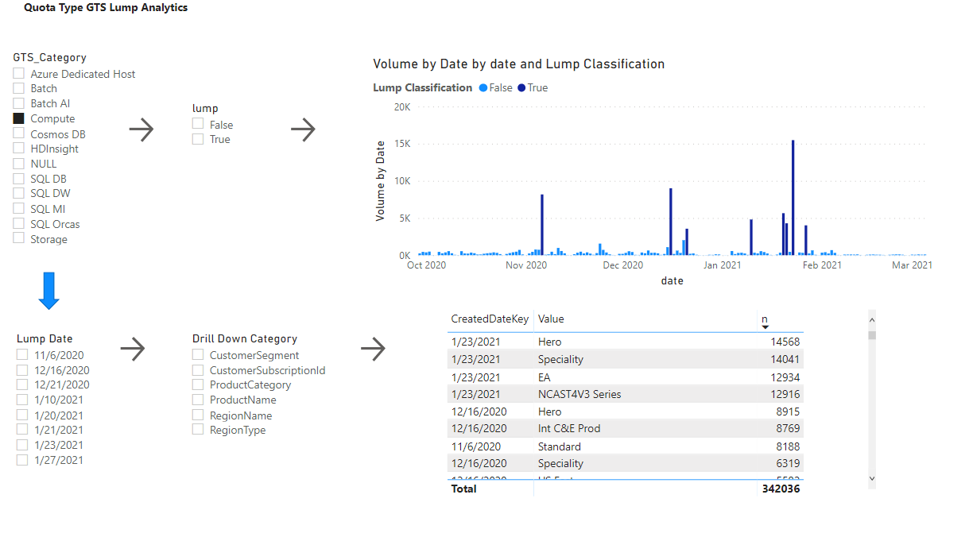
RDQuota Phase II: Lump (One-time Events)
1
Inter-Range Quantile Classification to flag batch events within GTS time series (Compute shown)
1
2
Lump orders shown
2

Slide 6
RDQuota Phase III Goals
In Phase II we have achieved:
High performance decomposition of Seasonality within different groups
Classification of one-time events within time series groups
Drill-down analytics on classified one-time events
Phase III Goals
Triangulate manufacturing data against lump classifications
Provide expected volume breakdowns for one-time events
Predict one-time events (Reach goal)

